Slide 1
Electrical Resistivity Processing Workflow
Last updated 10/18/2020

Slide 2
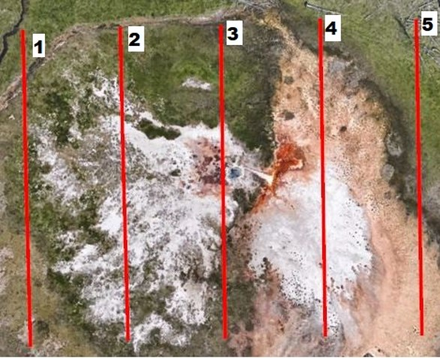
Data Collection Info
5 resistivity datasets were collected in parallel lines crossing over Rosette Spring
Geometry of each line
2m electrode spacing
56 electrode, 110m long line
Data Collection File -> rawdata_stg.txt

Slide 3
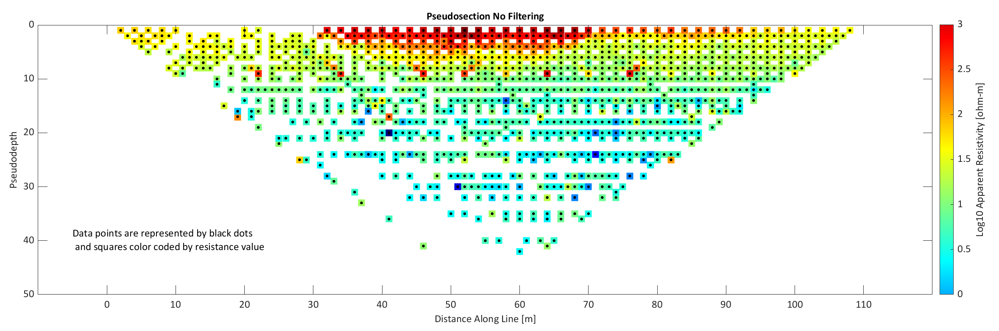
1. Plot Raw data Pseudosection

Slide 4
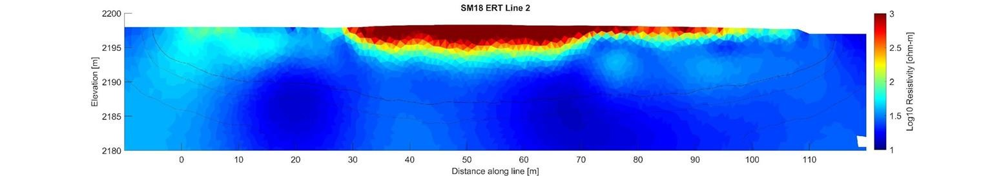
2. Use exported csv w/ unfiltered data to perform geophysical inversion
Model is over fitting the data (Final RMS > 1)
a_wgt = 0.01
Iterations = 2
DOI 0.4 0.6 0.8
b_wgt = 0.02 Final RMS = 1.17 SenLev = -5
# data kept = 1783/1783 ~ 100%

Slide 5
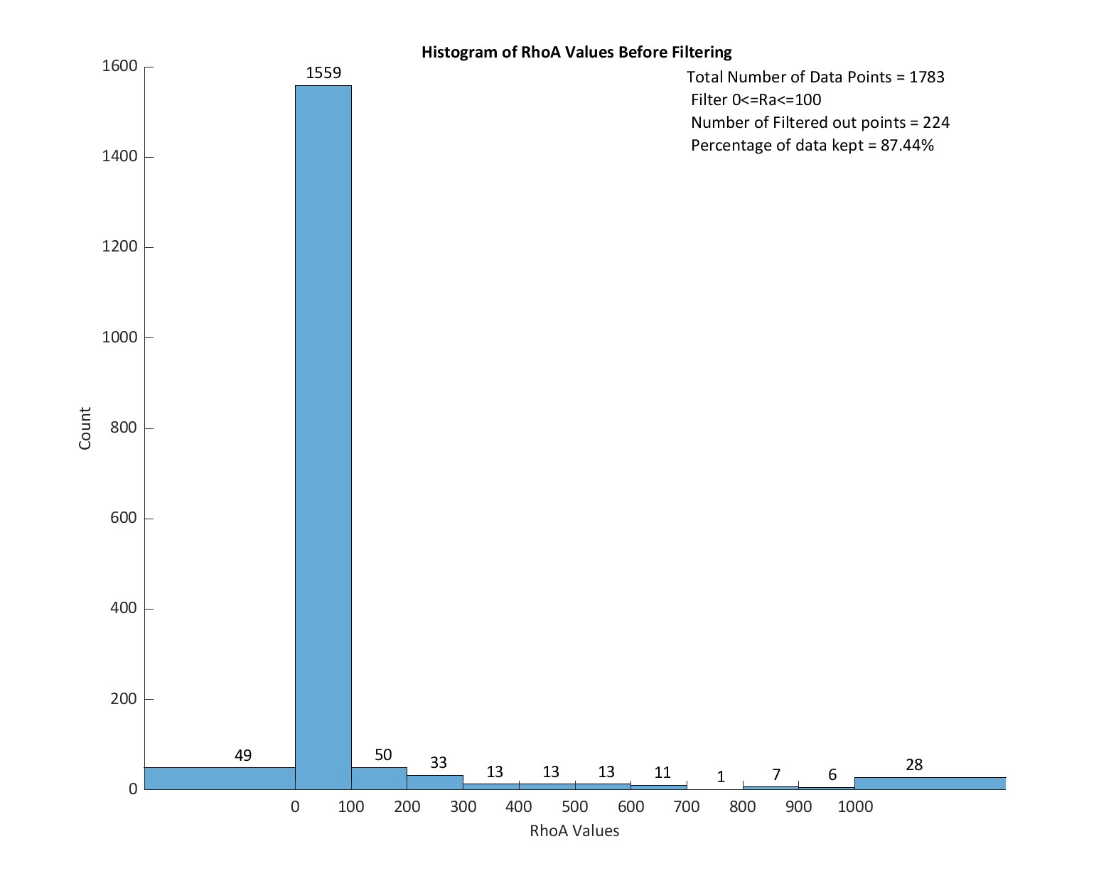
3. Let’s look at the Raw Data Again…
Histogram showing apparent resistivity (RhoA) distribution. Vast majority of the data is in the
0 <= RhoA < 100 range
Try filtering the data:
⮚ 0 <= RhoA < 100

Slide 6
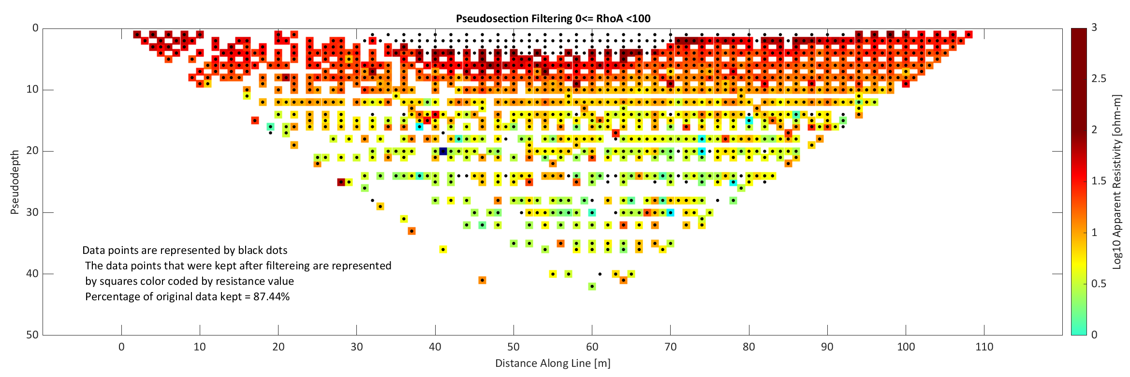
4. Pseudosection with filtering 0<= RhoA< 100
Percentage of data points kept = 1559/1783 ~ 87.44%

Slide 7
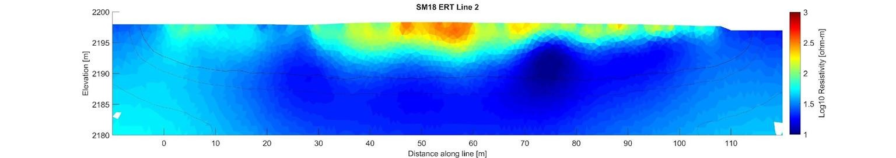
5. Use exported csv w/ filtered data to perform geophysical inversion
FINAL RESULT
a_wgt = 0.01
Iterations = 2
DOI 0.4 0.6 0.8
b_wgt = 0.02 Final RMS = 1.00 SenLev = -5

